Slide 1
Recurrent Chunking Mechanisms for
Long-Text Machine Reading Comprehension
ACL 2020

Slide 2
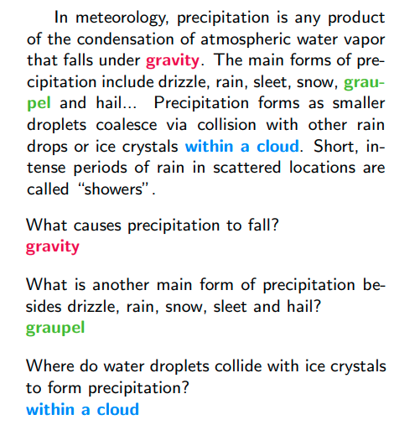

Slide 3
CLS
question
SEP
document
SEP
BERT
CLS
question
SEP
document
SEP

Slide 4
start=32,end=32
CLS
question
SEP
document
SEP
BERT
CLS
question
SEP
document
SEP
What causes precipitation to fall?

Slide 5
CLS
question
SEP
document
SEP
整个序列长度不能超过512个单词

Slide 6
The Vatican Apostolic Library, more commonly called the Vatican Library or simply the Vat, is the library of the Holy See, located in Vatican City. Formally established in 1475, although it is much older, it is one of the oldest libraries in the world and contains one of the most significant collections of historical texts. It has 75,000 codices from throughout history, as well as 1.1 million printed books, which include some 8,500 incunabula. The Vatican Library is a research library for history, law, philosophy, science and theology. The Vatican Library is open to anyone who can document their qualifications and research needs. Photocopies for private study of pages from books published between 1801 and 1990 can be requested in person or by mail. In March 2014, the Vatican Library began an initial four-year project of digitising its collection of manuscripts, to be made available online. The Vatican Secret Archives were separated from the library at the beginning of the 17th century; they contain another 150,000 items. Scholars have traditionally divided the history of the library into five periods, Pre-Lateran, Lateran, Avignon, Pre-Vatican. dated from the earliest days of the Church. Only a handful of volumes survive from this period, though some are very significant.
CLS
question
SEP
document
SEP
整个序列长度不能超过512个单词

Slide 7
假如question的长度为9,整个document的长度是700
512-9-3=500
CLS
question
SEP
document
SEP
最长是500个单词

Slide 8
假如question的长度为9,整个document的长度是700
512-9-3=500
CLS
question
SEP
document
SEP
最长是500个单词

Slide 9
假如question的长度为9,整个document的长度是700
512-9-3=500
segment1 segment2 segment3
CLS
question
SEP
segment1
SEP
CLS
question
SEP
segment2
SEP
CLS
question
SEP
segment3
SEP

Slide 10
缺点１：各个segment之间是独立的，每一个segment和question作为一个独立的example输入到BERT

Slide 11
start=105,end=110
CLS
question
SEP
segment3
SEP
start=60,end=65
BERT
CLS
question
SEP
segment2
SEP
start=10,end=15
CLS
question
SEP
segment3
SEP
BERT
CLS
question
SEP
segment1
SEP
CLS
question
SEP
segment2
SEP
BERT
CLS
question
SEP
segment1
SEP

Slide 12
缺点１：各个segment之间是独立的，每一个segment和question作为一个独立的example输入到BERT
缺点２：固定切分窗口大小会导致某些segment中，答案的上下文不足

Slide 13
The Vatican Apostolic Library (), more commonly called the Vatican Library or simply the Vat, is the library of the H oly See, located in Vatican City. Formally established in 1475, although it is much older, it is one of the oldest libraries in the w orld and contains one of the most significant collections of historical texts. It has 75,000 codices from throughout history, as well as 1.1 million printed books, which include some 8,500 incunabula. The Vatican Library is a research library for history, law, philosophy, science and theology. The Vatican Library is open to anyone who can document their qualifications and research needs. Phot ocopies for private study of pages from books published between 1801 and 1990 can be requested in person or by mail. In March 201 4, the Vatican Library began an initial four-year project of digitising its collection of manuscripts, to be made available online. The Vatican Secret Archives were separated from the library at the beginning of the 17th century; they contain another 150,000 ite ms. Scholars have traditionally divided the history of the library into five periods, Pre-Lateran, Lateran, Avignon, Pre-Vatican and Vatican. The Pre-Lateran period, comprising the initial days of the library, dated from the earliest days of the Church. Only a handful of volumes survive from this period, though some are very significant.

Slide 14
The Vatican Apostolic Library (), more commonly called the Vatican Library or simply the Vat, is the library of the H oly See, located in Vatican City. Formally established in 1475, although it is much older, it is one of the oldest libraries in the w orld and contains one of the most significant collections of historical texts. It has 75,000 codices from throughout history, as well as 1.1 million printed books, which include some 8,500 incunabula. The Vatican Library is a research library for history, law, philosophy, science and theology. The Vatican Library is open to anyone who can document their qualifications and research needs. Phot ocopies for private study of pages from books published between 1801 and 1990 can be requested in person or by mail. In March 201 4, the Vatican Library began an initial four-year project of digitising its collection of manuscripts, to be made available online. The Vatican Secret Archives were separated from the library at the beginning of the 17th century; they contain another 150,000 ite ms. Scholars have traditionally divided the history of the library into five periods, Pre-Lateran, Lateran, Avignon, Pre-Vatican and Vatican. The Pre-Lateran period, comprising the initial days of the library, dated from the earliest days of the Church. Only a handful of volumes survive from this period, though some are very significant.

Slide 15
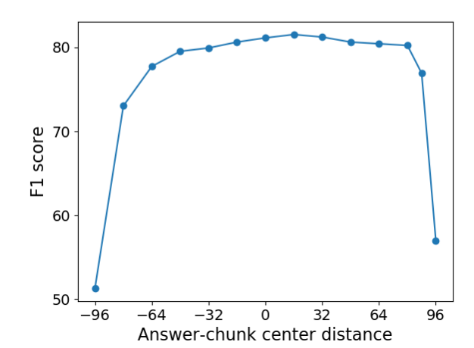

Slide 16
Recurrent Chunking Mechanisms for
Long-Text Machine Reading Comprehension

Slide 18
CLS
question
SEP
segment3
SEP
BERT
CLS
question
SEP
segment2
SEP
CLS
question
SEP
segment3
SEP
BERT
CLS
question
SEP
segment1
SEP
CLS
question
SEP
segment2
SEP
BERT
CLS
question
SEP
segment1
SEP

Slide 19
CLS
question
SEP
segment3
SEP
BERT
CLS
question
SEP
segment2
SEP
CLS
question
SEP
segment3
SEP
BERT
CLS
question
SEP
segment1
SEP
CLS
question
SEP
segment2
SEP
BERT
CLS
question
SEP
segment1
SEP

Slide 20



CLS
question
SEP
segment3
SEP
BERT
LSTM
CLS
question
SEP
segment3
SEP
CLS
question
SEP
segment2
SEP
LSTM
BERT
CLS
question
SEP
segment1
SEP
CLS
question
SEP
segment2
SEP
BERT
CLS
question
SEP
segment1
SEP

Slide 21
state
Agent
action
Enviroment

Slide 22
state
Agent
action
reward
Enviroment

Slide 23

输入给NN一个state s,NN根据自身的策略输出一个action a.
NN
state
action

Slide 24
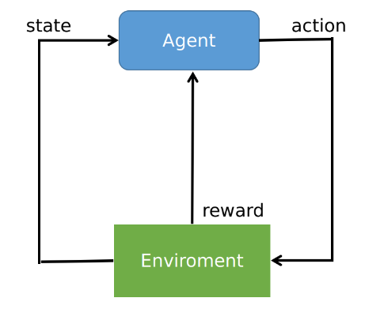



定义目标函数（从trajectory的角度）

Slide 26
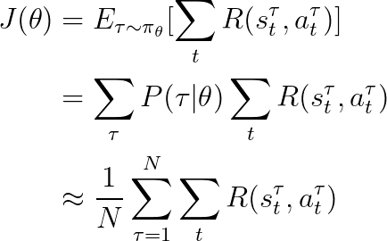

Slide 27
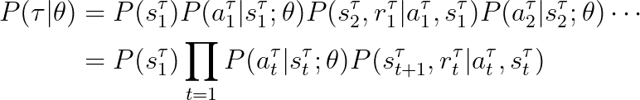

Slide 29


Slide 31
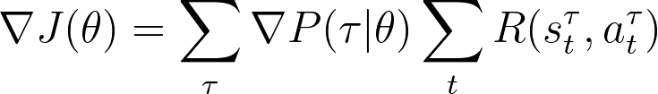

Slide 32
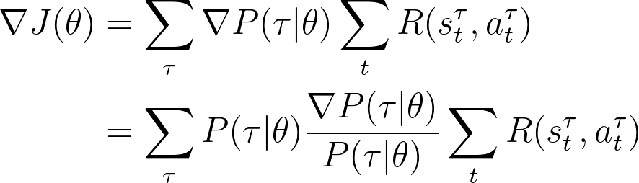

Slide 33
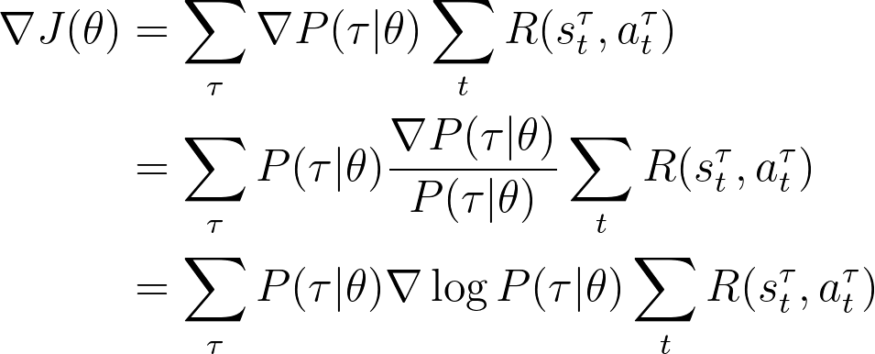

Slide 34
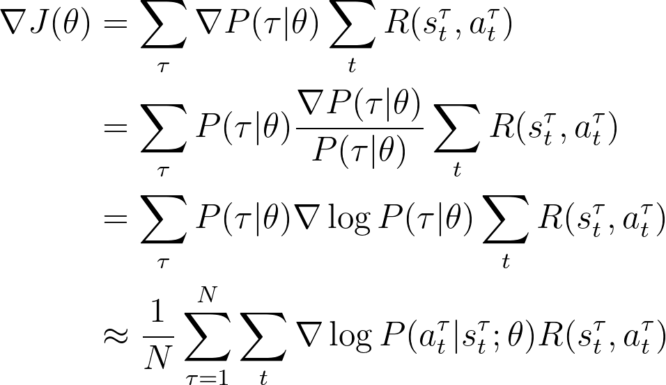

Slide 35


Slide 36
输入给NN一个state s,NN根据自身的策略输出一个action a.
NN
state
action
状态，行为，奖励，策略

Slide 37
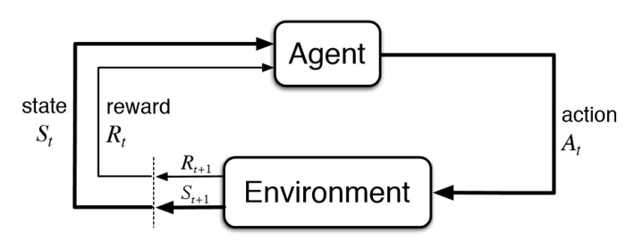

Slide 38
The Vatican Apostolic Library (), more commonly called the Vatican Library or simply the Vat, is the library of the H oly See, located in Vatican City. Formally established in 1475, although it is much older, it is one of the oldest libraries in the w orld and contains one of the most significant collections of historical texts. It has 75,000 codices from throughout history, as well as 1.1 million printed books, which include some 8,500 incunabula. The Vatican Library is a research library for history, law, philosophy, science and theology. The Vatican Library is open to anyone who can document their qualifications and research needs. Phot ocopies for private study of pages from books published between 1801 and 1990 can be requested in person or by mail. In March 201 4, the Vatican Library began an initial four-year project of digitising its collection of manuscripts, to be made available online. The Vatican Secret Archives were separated from the library at the beginning of the 17th century; they contain another 150,000 ite ms. Scholars have traditionally divided the history of the library into five periods, Pre-Lateran, Lateran, Avignon, Pre-Vatican and Vatican. The Pre-Lateran period, comprising the initial days of the library, dated from the earliest days of the Church. Only a handful of volumes survive from this period, though some are very significant.

Slide 39
The Vatican Apostolic Library (), more commonly called the Vatican Library or simply the Vat, is the library of the H oly See, located in Vatican City. Formally established in 1475, although it is much older, it is one of the oldest libraries in the w orld and contains one of the most significant collections of historical texts. It has 75,000 codices from throughout history, as well as 1.1 million printed books, which include some 8,500 incunabula. The Vatican Library is a research library for history, law, philosophy, science and theology. The Vatican Library is open to anyone who can document their qualifications and research needs. Phot ocopies for private study of pages from books published between 1801 and 1990 can be requested in person or by mail. In March 201 4, the Vatican Library began an initial four-year project of digitising its collection of manuscripts, to be made available online. The Vatican Secret Archives were separated from the library at the beginning of the 17th century; they contain another 150,000 ite ms. Scholars have traditionally divided the history of the library into five periods, Pre-Lateran, Lateran, Avignon, Pre-Vatican and Vatican. The Pre-Lateran period, comprising the initial days of the library, dated from the earliest days of the Church. Only a handful of volumes survive from this period, though some are very significant.

Slide 41
The Vatican Apostolic Library (), more commonly called the Vatican Library or simply the Vat, is the library of the H oly See, located in Vatican City. Formally established in 1475, although it is much older, it is one of the oldest libraries in the w orld and contains one of the most significant collections of historical texts. It has 75,000 codices from throughout history, as well as 1.1 million printed books, which include some 8,500 incunabula. The Vatican Library is a research library for history, law, philosophy, science and theology. The Vatican Library is open to anyone who can document their qualifications and research needs. Phot ocopies for private study of pages from books published between 1801 and 1990 can be requested in person or by mail. In March 201 4, the Vatican Library began an initial four-year project of digitising its collection of manuscripts, to be made available online. The Vatican Secret Archives were separated from the library at the beginning of the 17th century; they contain another 150,000 ite ms. Scholars have traditionally divided the history of the library into five periods, Pre-Lateran, Lateran, Avignon, Pre-Vatican and Vatican. The Pre-Lateran period, comprising the initial days of the library, dated from the earliest days of the Church. Only a handful of volumes survive from this period, though some are very significant.
The Vatican Apostolic Library (), more commonly called the Vatican Library or simply the Vat, is the library of the H oly See, located in Vatican City. Formally established in 1475, although it is much older, it is one of the oldest libraries in the w orld and contains one of the most significant collections of historical texts. It has 75,000 codices from throughout history, as well as 1.1 million printed books, which include some 8,500 incunabula. The Vatican Library is a research library for history, law, philosophy, science and theology. The Vatican Library is open to anyone who can document their qualifications and research needs. Phot
CLS
question
SEP
document
SEP

Slide 42
行为空间＝{-16,16,32,64,128}
The Vatican Apostolic Library (), more commonly called the Vatican Library or simply the Vat, is the library of the H oly See, located in Vatican City. Formally established in 1475, although it is much older, it is one of the oldest libraries in the w orld and contains one of the most significant collections of historical texts. It has 75,000 codices from throughout history, as well as 1.1 million printed books, which include some 8,500 incunabula. The Vatican Library is a research library for history, law, philosophy, science and theology. The Vatican Library is open to anyone who can document their qualifications and research needs. Phot
start=50,end=51
NN
a=32
recurrent_state
CLS
question
SEP
document
SEP

Slide 43
行为空间＝{-16,16,32,64,128}
The Vatican Apostolic Library (), more commonly called the Vatican Library or simply the Vat, is the library of the H oly See, located in Vatican City. Formally established in 1475, although it is much older, it is one of the oldest libraries in the w orld and contains one of the most significant collections of historical texts. It has 75,000 codices from throughout history, as well as 1.1 million printed books, which include some 8,500 incunabula. The Vatican Library is a research library for history, law, philosophy, science and theology. The Vatican Library is open to anyone who can document their qualifications and research needs. Phot
start=50,end=51
NN
a=32
recurrent_state
CLS
question
SEP
document
SEP

Slide 44


行为空间＝{-16,16,32,64,128}
The Vatican Apostolic Library (), more commonly called the Vatican Library or simply the Vat, is the library of the H oly See, located in Vatican City. Formally established in 1475, although it is much older, it is one of the oldest libraries in the w orld and contains one of the most significant collections of historical texts. It has 75,000 codices from throughout history, as well as 1.1 million printed books, which include some 8,500 incunabula. The Vatican Library is a research library for history, law, philosophy, science and theology. The Vatican Library is open to anyone who can document their qualifications and research needs. Phot
start=50,end=51
NN
a=32
recurrent_state
CLS
question
SEP
document
SEP

Slide 45

行为空间＝{-16,16,32,64,128}
The Vatican Apostolic Library (), more commonly called the Vatican Library or simply the Vat, is the library of the H oly See, located in Vatican City. Formally established in 1475, although it is much older, it is one of the oldest libraries in the w orld and contains one of the most significant collections of historical texts. It has 75,000 codices from throughout history, as well as 1.1 million printed books, which include some 8,500 incunabula. The Vatican Library is a research library for history, law, philosophy, science and theology. The Vatican Library is open to anyone who can document their qualifications and research needs. Phot
start=50,end=51
NN
a=32
recurrent_state

Slide 46

行为空间＝{-16,16,32,64,128}
The Vatican Apostolic Library (), more commonly called the Vatican Library or simply the Vat, is the library of the H oly See, located in Vatican City. Formally established in 1475, although it is much older, it is one of the oldest libraries in the w orld and contains one of the most significant collections of historical texts. It has 75,000 codices from throughout history, as well as 1.1 million printed books, which include some 8,500 incunabula. The Vatican Library is a research library for history, law, philosophy, science and theology. The Vatican Library is open to anyone who can document their qualifications and research needs. Phot
start=50,end=51
NN
a=32
recurrent_state
CLS
question
SEP
document
SEP
BERT
CLS
question
SEP
document
SEP

Slide 47
行为空间＝{-16,16,32,64,128}
The Vatican Apostolic Library (), more commonly called the Vatican Library or simply the Vat, is the library of the H oly See, located in Vatican City. Formally established in 1475, although it is much older, it is one of the oldest libraries in the w orld and contains one of the most significant collections of historical texts. It has 75,000 codices from throughout history, as well as 1.1 million printed books, which include some 8,500 incunabula. The Vatican Library is a research library for history, law, philosophy, science and theology. The Vatican Library is open to anyone who can document their qualifications and research needs. Phot
start=50,end=51
NN
a=32
recurrent_state
CLS
question
SEP
document
SEP
把当前segment的CLS位置表示向量以及上一个segment的recurrent_state通过LSTM，LSTM的输出用来判断当前的segment包含answer的概率
BERT
CLS
question
SEP
document
SEP

Slide 48
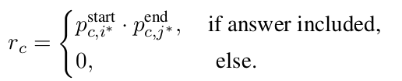
行为空间＝{-16,16,32,64,128}
The Vatican Apostolic Library (), more commonly called the Vatican Library or simply the Vat, is the library of the H oly See, located in Vatican City. Formally established in 1475, although it is much older, it is one of the oldest libraries in the w orld and contains one of the most significant collections of historical texts. It has 75,000 codices from throughout history, as well as 1.1 million printed books, which include some 8,500 incunabula. The Vatican Library is a research library for history, law, philosophy, science and theology. The Vatican Library is open to anyone who can document their qualifications and research needs. Phot
start=50,end=51
NN
a=32
recurrent_state
CLS
question
SEP
document
SEP
把当前segment的CLS位置表示向量以及上一个segment的recurrent_state通过LSTM，LSTM的输出用来判断当前的segment包含answer的概率
BERT
CLS
question
SEP
document
SEP

Slide 49

行为空间＝{-16,16,32,64,128}
The Vatican Library is a research library for history, law, philosophy, science and theology. The Vatican Library is open to anyone who can document their qualifications and research needs. Phot ocopies for private study of pages from books published between 1801 and 1990 can be requested in person or by mail. In March 201 4, the Vatican Library began an initial four-year project of digitising its collection of manuscripts, to be made available online. The Vatican Secret Archives were separated from the library at the beginning of the 17th century; they contain another 150,000 ite ms. Scholars have traditionally divided the history of the library into five periods, Pre-Lateran, Lateran, Avignon, Pre-Vatican and Vatican. The Pre-Lateran period, comprising the initial days of the library,
start=15,end=16
NN
a=-16
recurrent_state
CLS
question
SEP
document
SEP
把当前segment的CLS位置表示向量以及上一个segment的recurrent_state通过LSTM，LSTM的输出用来判断当前的segment包含answer的概率
BERT
CLS
question
SEP
document
SEP

Slide 50
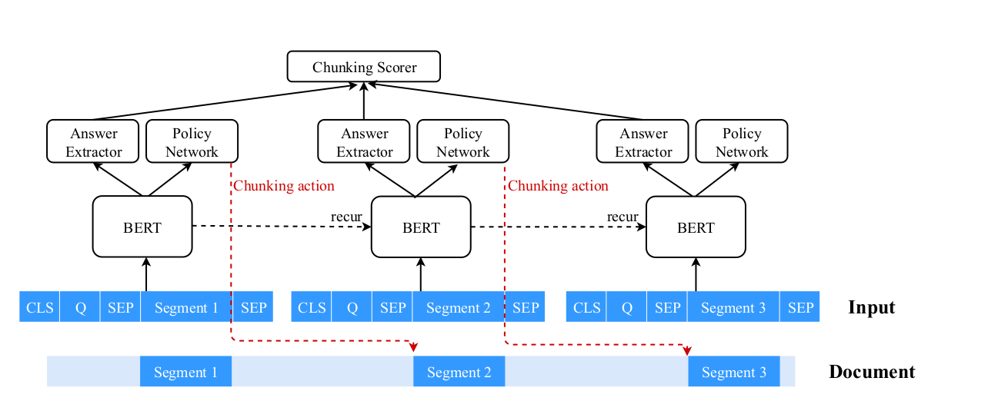

Slide 52
模型预测当前的segment包含答案的概率

Slide 53
模型预测当前的segment包含答案的概率
模型从当前segment提取出答案位置的概率

Slide 54
模型预测当前的segment包含答案的概率
未来的累计奖励
模型从当前segment提取出答案位置的概率

Slide 55
AE: Answer Extractor
CS: Chunking Scorer
CP: Chuning Policy

Slide 56
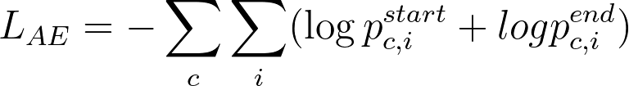
AE: Answer Extractor
CS: Chunking Scorer
CP: Chuning Policy

Slide 57
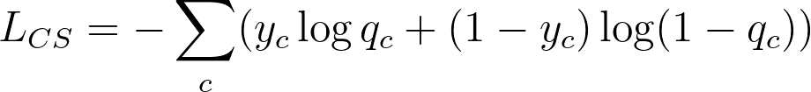
AE: Answer Extractor
CS: Chunking Scorer
CP: Chuning Policy

Slide 58
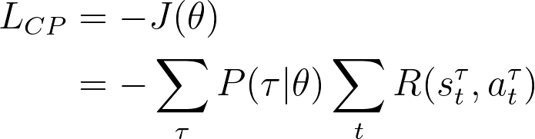
AE: Answer Extractor
CS: Chunking Scorer
CP: Chuning Policy

Slide 59
AE: Answer Extractor
CS: Chunking Scorer
CP: Chuning Policy

Slide 61
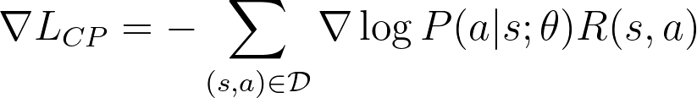

Slide 62
CLS
question
SEP
document
SEP

